Slide 1
What Is The Effect Of The Earth's Temperature on Cyclonic Storms?
A Graphical Story by Umer Farooq

Slide 2
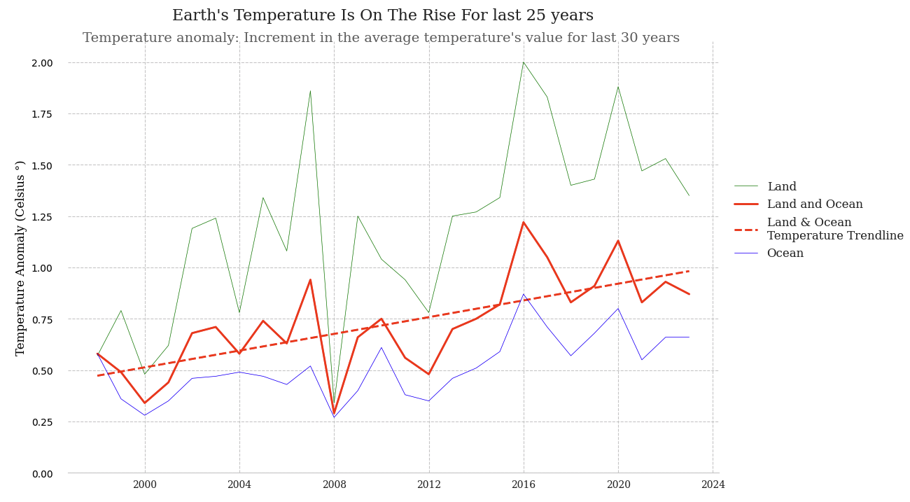
What Is Happening To The Earth’s Temperature?

Slide 3
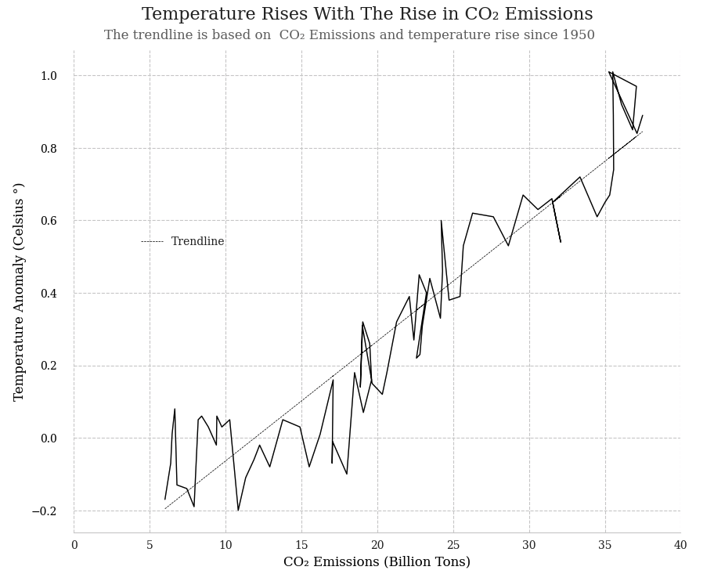
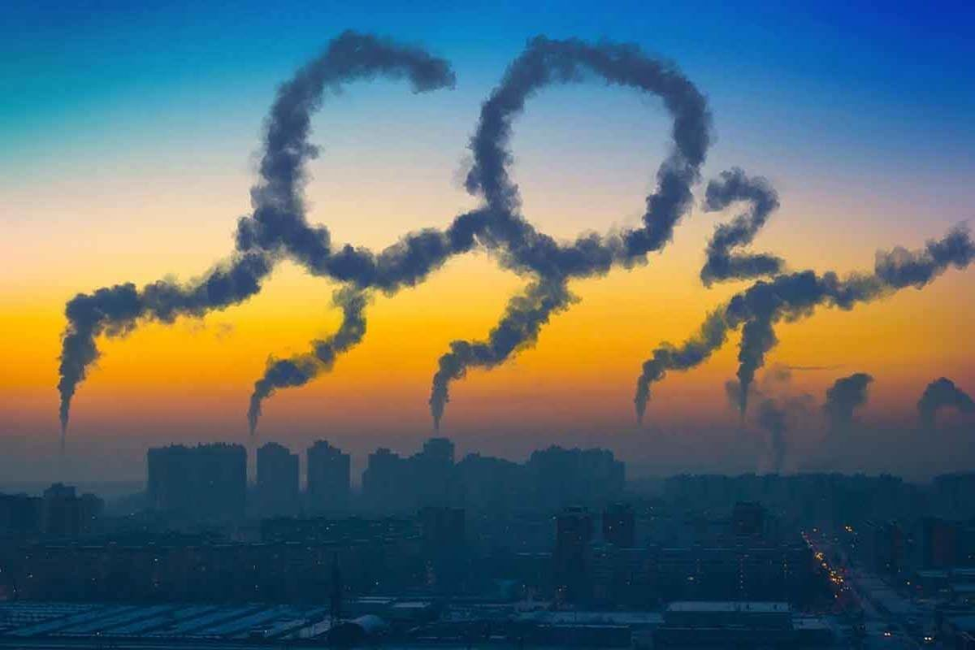
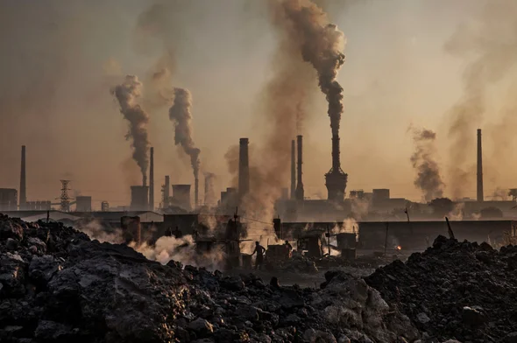
What Causes The Earth Temperature To Rise?

Slide 4
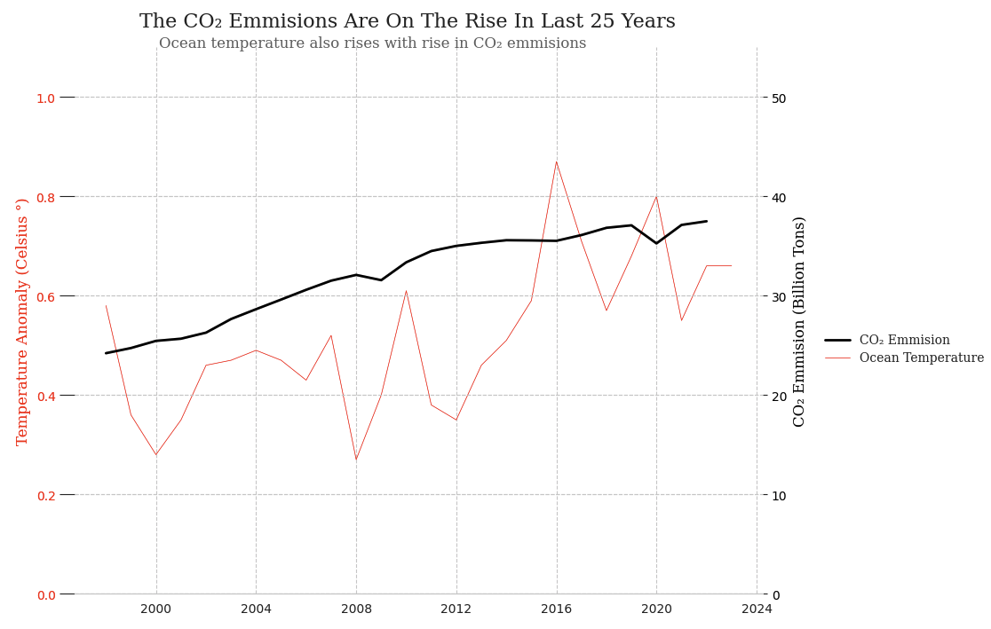
What Is The Trend of CO2 Emissions and its Effect of Ocean Temperature?

Slide 5
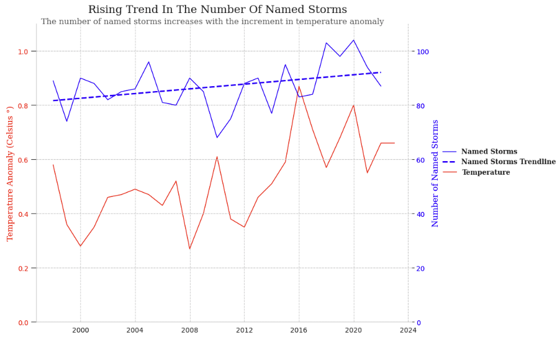
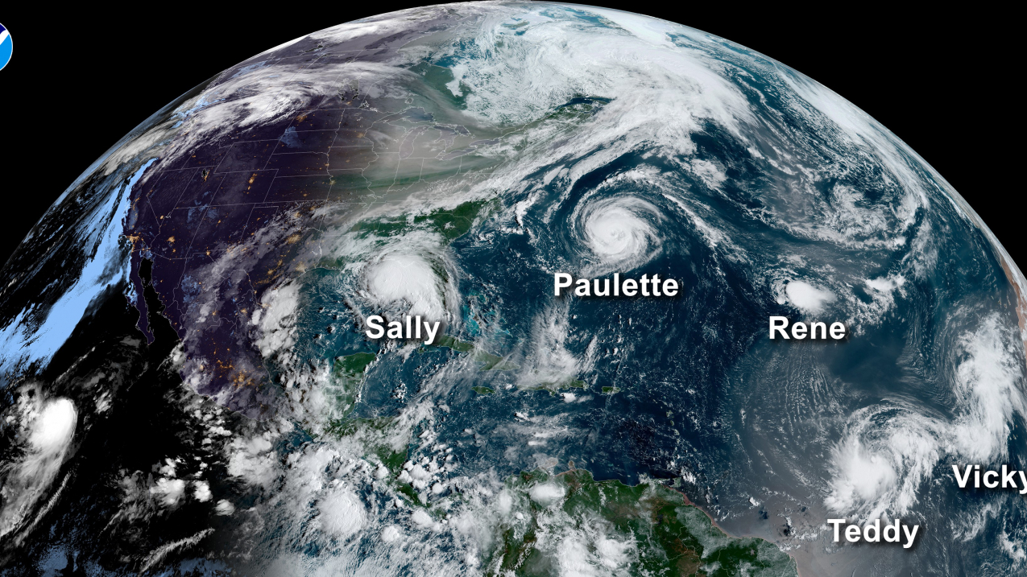
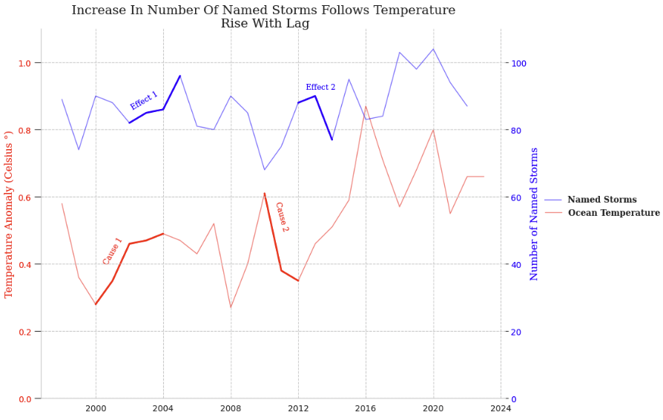
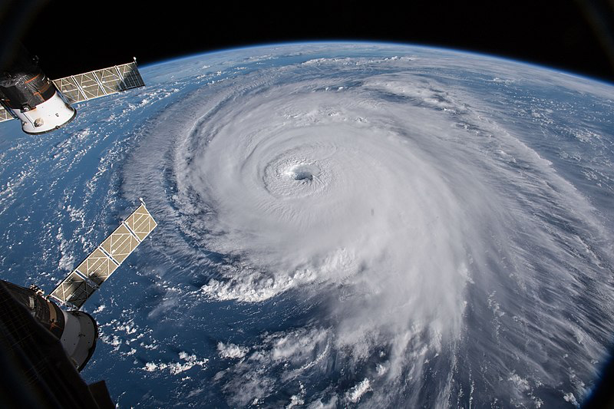
What Happens If The Ocean Temperature Rises?

Slide 6
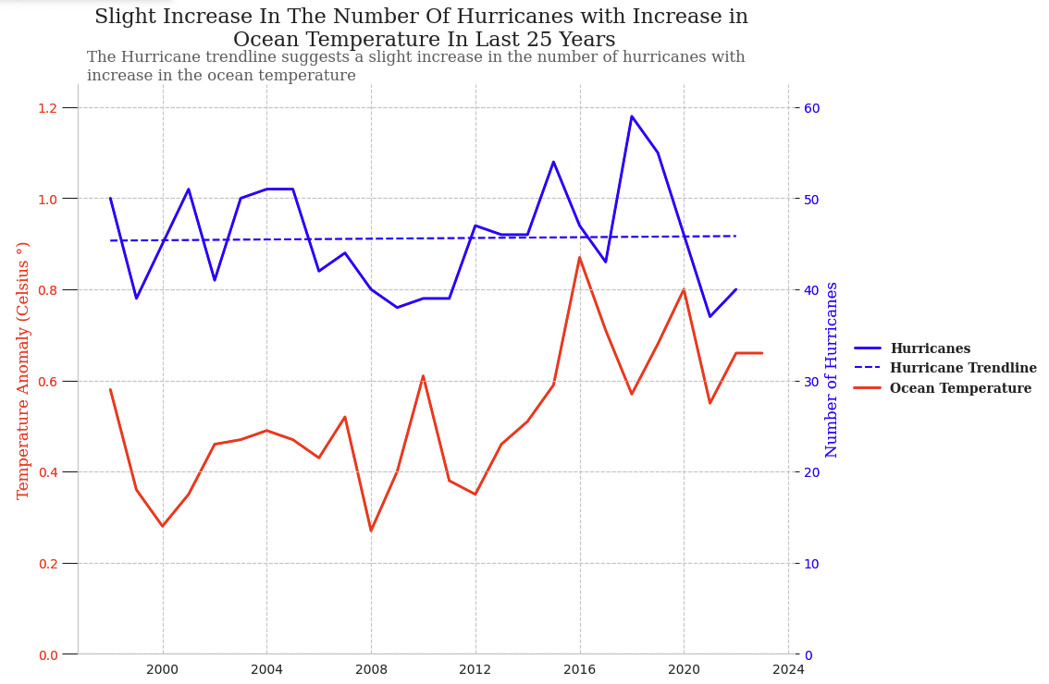
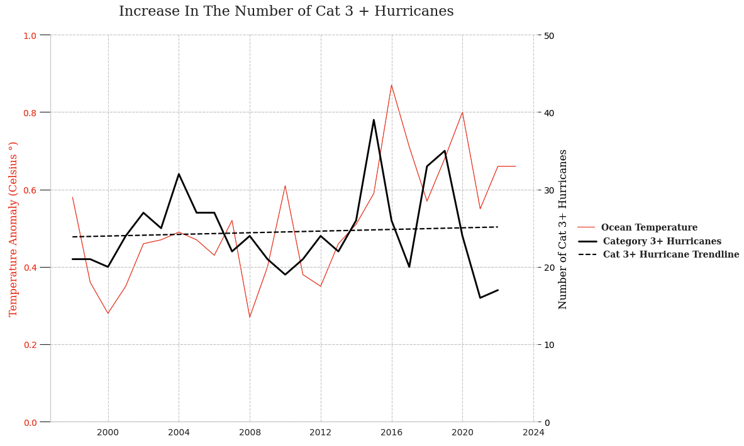
What Happens If The Ocean Temperature Rises? (Cont.)
The Number of Hurricanes Increases
The Intensity Also Increases as Category 3+ Hurricanes Are Becoming Frequent

Slide 7
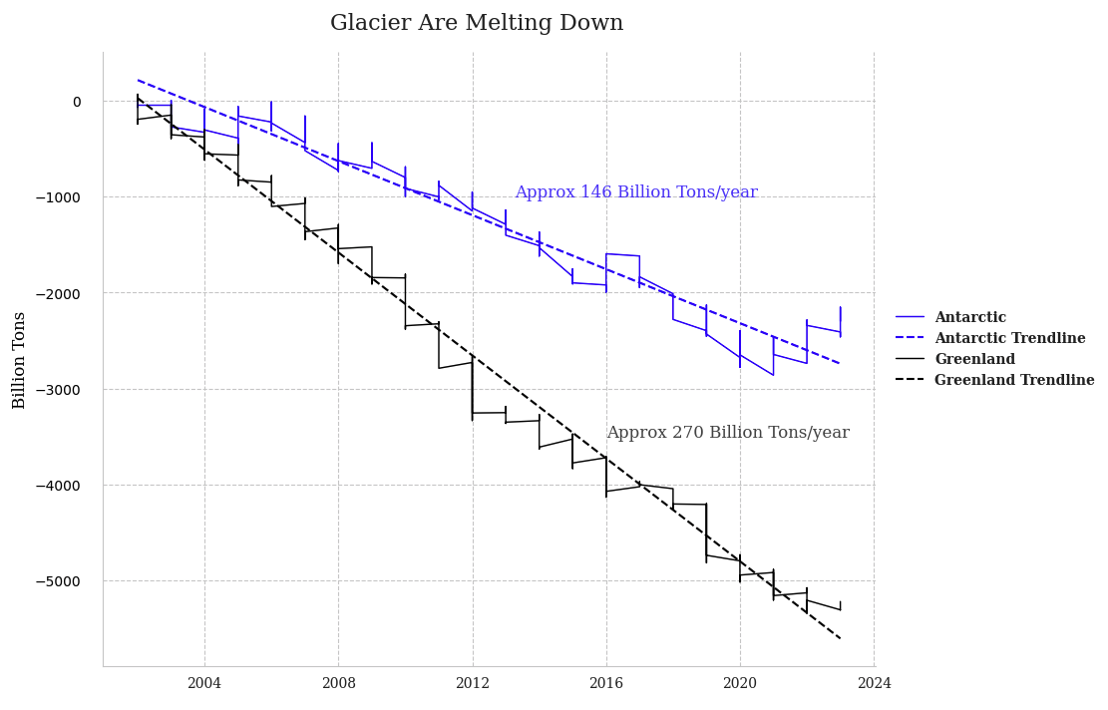
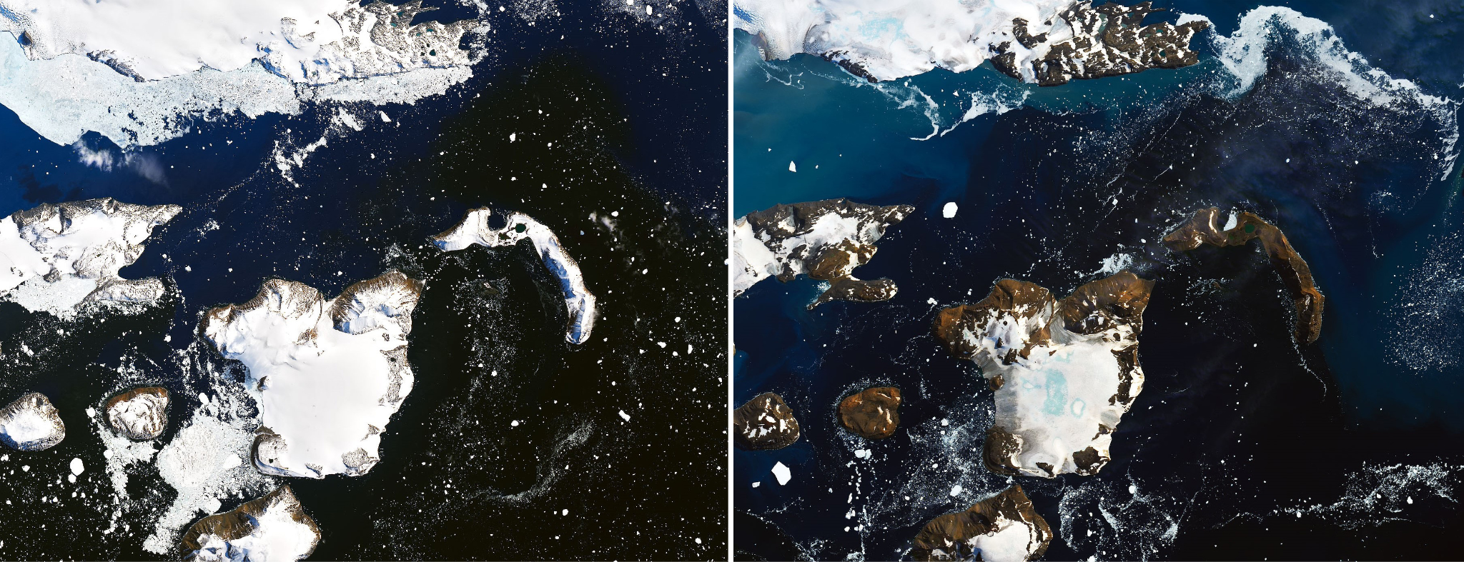
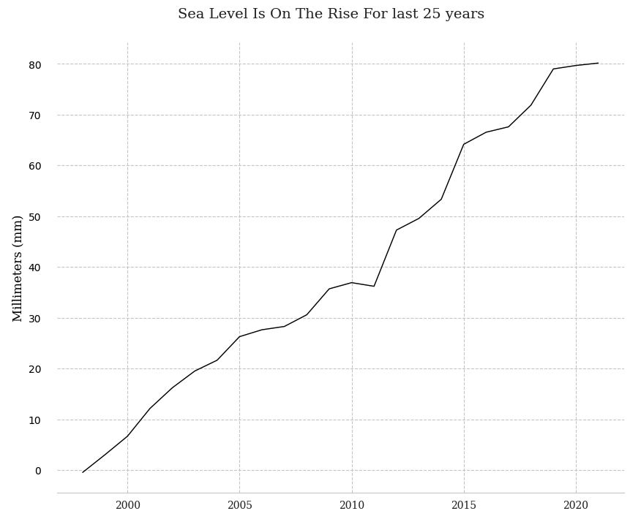
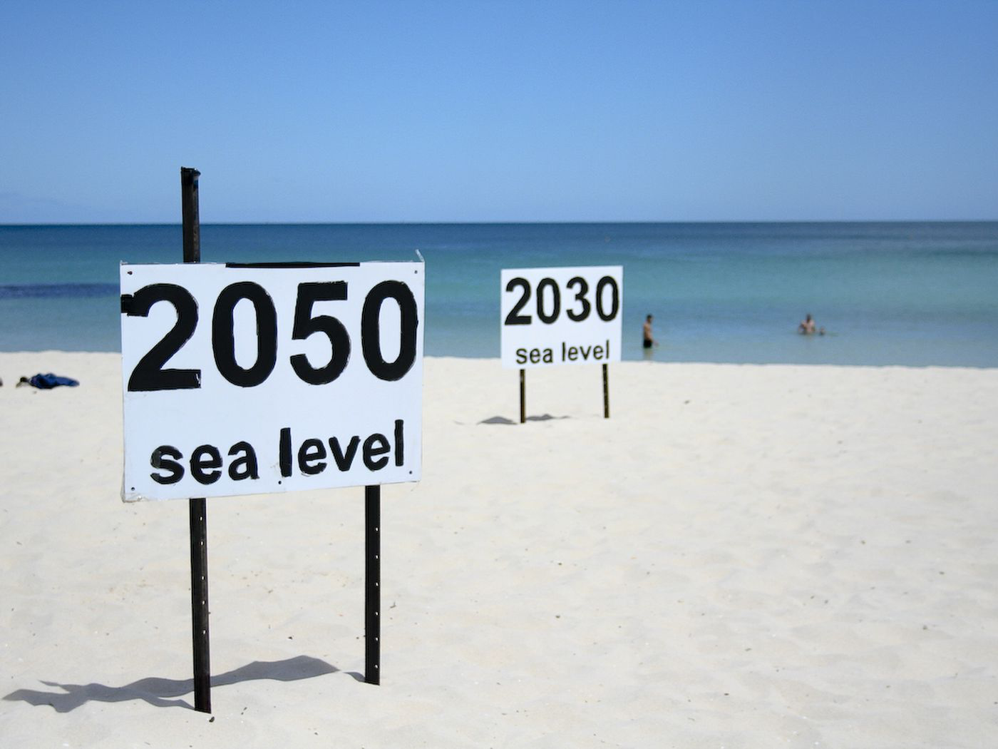
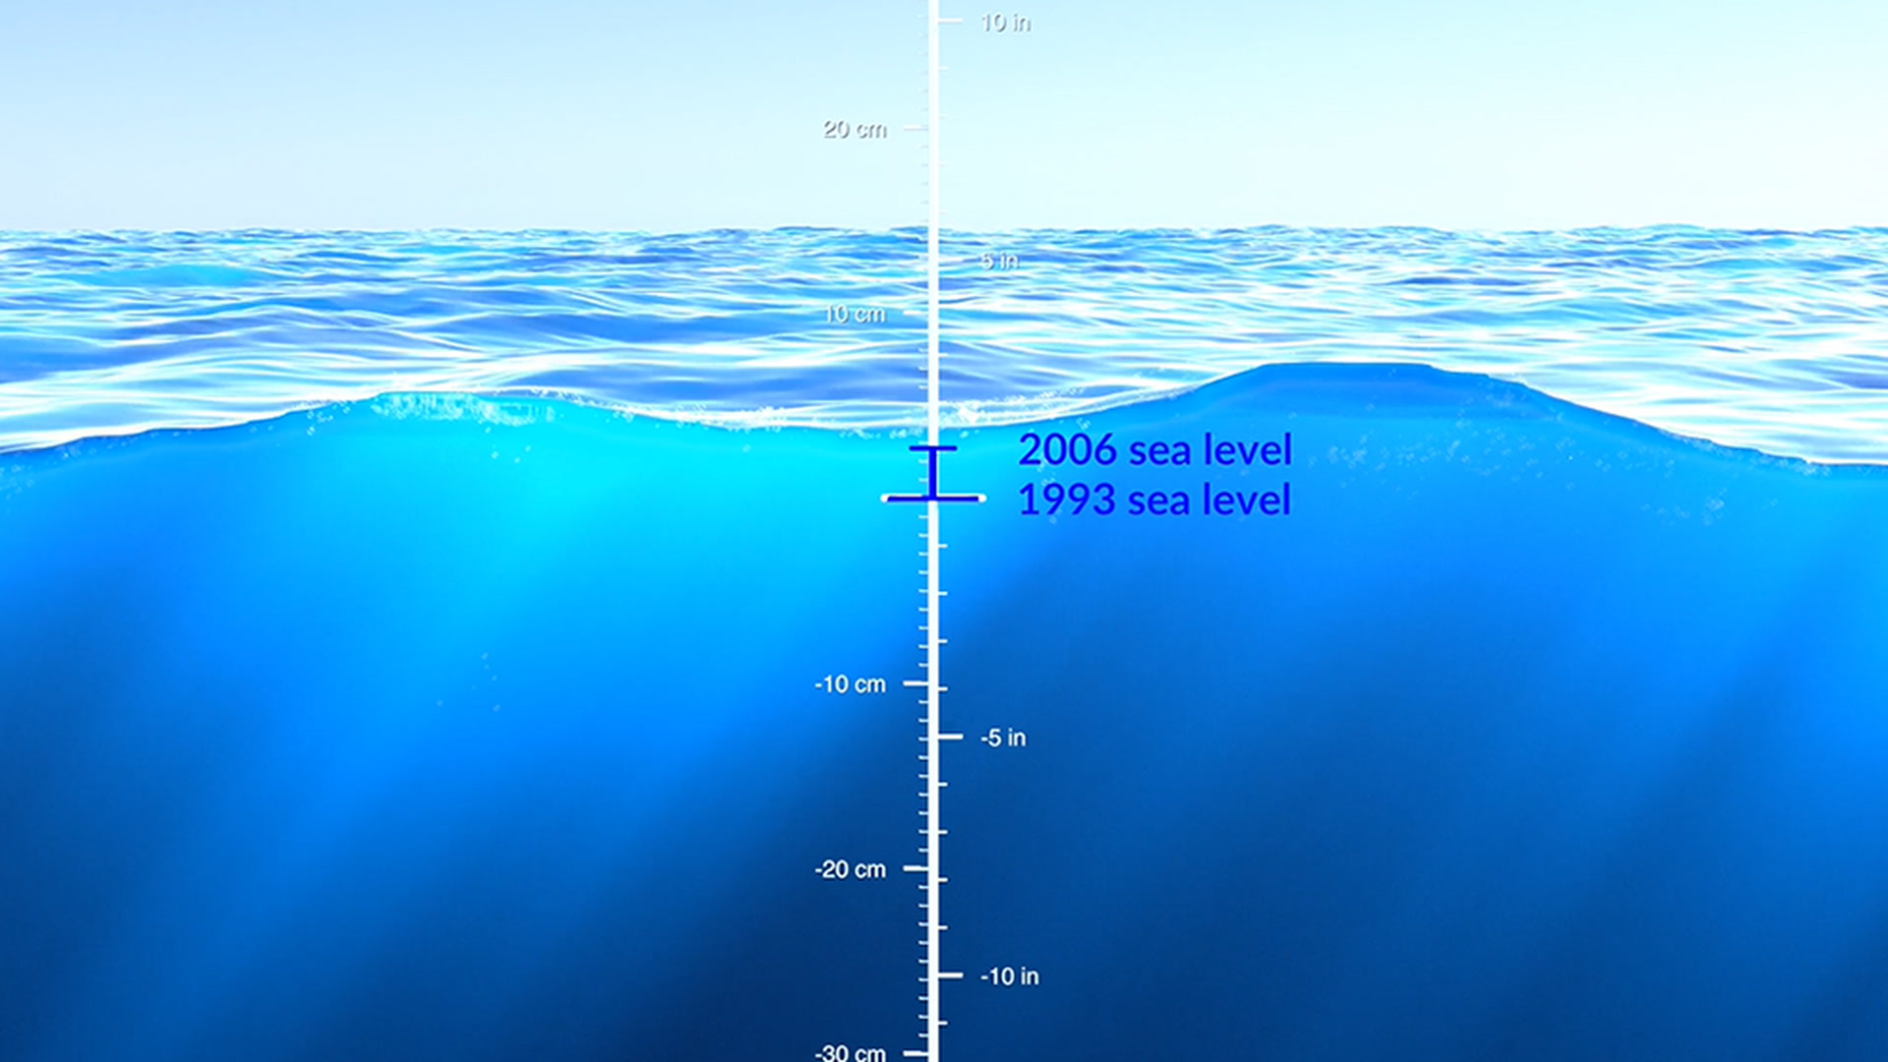
What Other Impact Does Rise in Land and Ocean Temperature Have?
Before
After

Slide 8
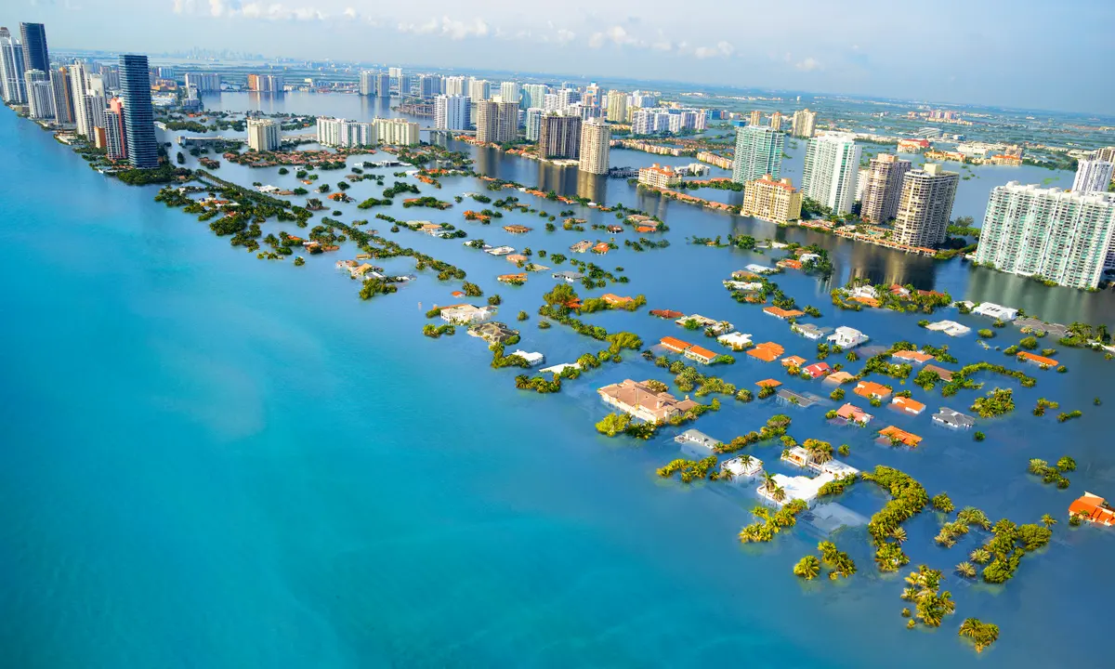
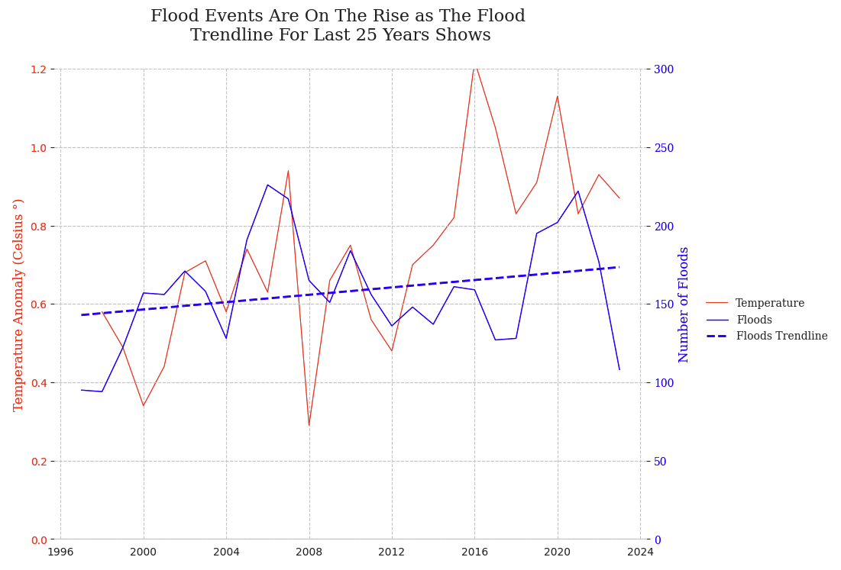
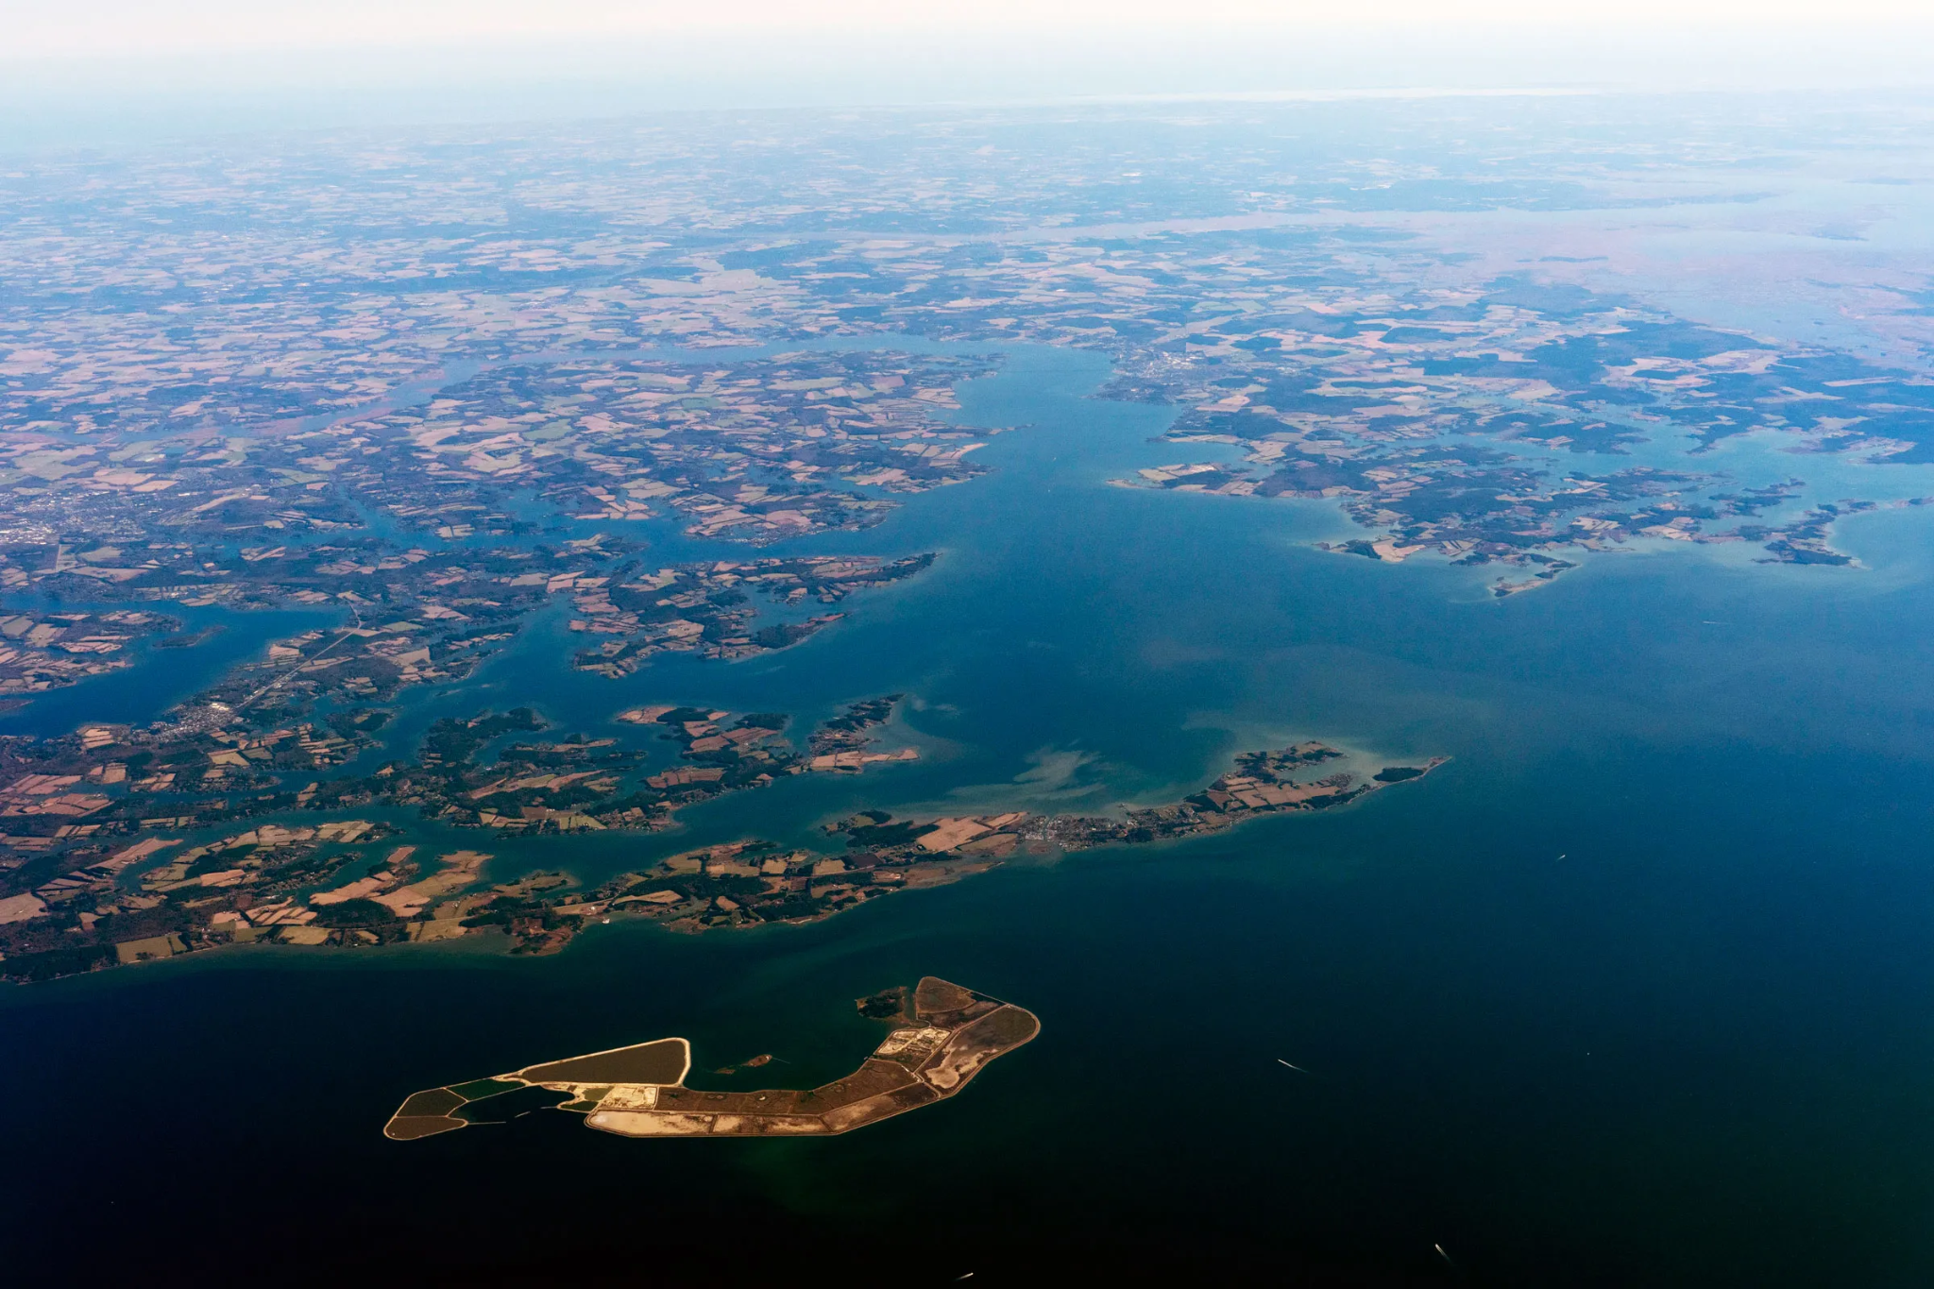
What Happens If The Sea Level Rises Due To Rise In Temperature?

Slide 9
References:
https://www.nasa.gov/stem-content/antarctic-ice-mass-data-set/
https://tropical.atmos.colostate.edu/Realtime/index.php?arch&loc=global
https://www.statista.com/statistics/276629/global-co2-emissions/#:~:text=Global%20carbon%20dioxide%20emissions%20from,by%20more%20than%2060%20percent
https://climate.nasa.gov/vital-signs/carbon-dioxide/
https://climate.nasa.gov/vital-signs/global-temperature/
https://gml.noaa.gov/ccgg/trends/gl_gr.html
https://www.emdat.be/
https://www.nasa.gov/stem-content/sea-level-height-data-set/

